Slide 1

Application Packaging
TC 8 / 9

Slide 2
Fire Alarm Test today
11:00
Alarm Test
Notes:
Don’t all run off ;)

Slide 3


Using Maven for Packaging
Yesterday we introduced the concept of packaging a software application to create a set of files that could be deployed to their target environment.
For Java, we will be creating a JAR file – a compressed file containing everything needed for our application to deploy and run our website.
Notes:
[READ SLIDE ALOUD]

Slide 4
Core Concepts
An application contains:
Your code
Resources for your app – text, images, data files
Database setup scripts and initial data
Third party code – frameworks, libraries, plugins
All these need combining together: Packaging
Notes:
We need packaging because an application is a patchwork quilt of pieces of code.
Some we write. Some comes from libraries.
Then we have various assets like images, audio clips, database scripts and more.
Whatever tool your platform uses, it will have some way of combining together specific versions into a single whole.

Slide 5
Maven package command
Maven is common in Java world
Loads third party libraries at specific versions
Can combine all assets into a Java .jar
Java's .jar file is a zipped-up bundle of all assets
Notes:
The slide walks through all the work that 'maven package' does for us.
It makes a single bundle – a zip file – containing all we need to deploy our app.
Our app follows a common modern best practice of containing an embedded web server.
This means that we can copy this bundle over, start the web server and the web server will start our app.
This simplifies what we have to do for deployment: we need to copy this file onto a host server.
But that's jumping ahead – for the next exercise, we'll be getting Jenkins to package up all our code.

Slide 6

Exercise 6: Packaging with Maven
We’ll create a pipeline stage called ‘Package’
Will insert a call-out to Maven inside this stage to package our code.
Then insert a line to instruct Maven to package the code as a JAR file and place it in a folder called ‘target’
So where has this target folder been placed?

Slide 7
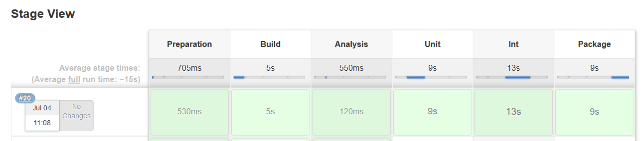
Exercise 6: Packaging with Maven Results

Slide 8
Alerting – Build Process
Jenkins can send alerts on events
Failed builds
Passing builds
Passing build after failed build(s)
Many different ways of alerting
Email
Slack
Sms
Notes:
Jenkins provides features to tell us how the build is getting on.
You'll find out that when you're busy at work, failed builds can go unnoticed – and stall the team.
Jenkins allows many ways of getting a message out to us – perhaps to say the build failed. Perhaps to say it's fixed.
There are many different mechanisms we can use.
The primary one is email – as it has always been.
But a more instant, modern approach is to get Jenkins to Slack a dev team channel: "Fix it you lot!"
Our next challenge for you is to find a way to get Jenkins to tell us that a build failed.
** Use Slack as our Jenkins setup can send to that.

Slide 9
Exercise: E-mail and Slack alerting
Research how to add slack alerting to your pipeline
Research how to add e-mail alerting to your pipeline.
AWS may restrict the Jenkins instance from sending out the e-mail as an anti-spam measure in the free tier, but you can still see the pipeline plugins, stages required. Everything in Jenkins itself is the same.
Check the console log to see what recipients, subject and body the e-mail has – don't worry if it doesn't arrive in your inbox.
Experiment with building up the subject and body using data from currentBuild – can you customise the e-mail to contain details of who submitted it, the name of the build and use different messages for whether it passed or failed?

Slide 10

Deployment
Notes:
Love this slide: "Right! Dealine's up! Just get it out the door!"

Slide 11
Basic Deployment concepts
Code must run – somewhere
On a user's device – phone, tablet, laptop
On a web application server
'In the cloud' - somebody else's servers
We need:
Packaged assets for our entire app
An execution environment
OS
Language runtimes
Environment variables
CPU, Memory, Power, Networking, Connected services
We can build, buy or rent these environments.
They can be small ...
Notes:
At last! The final – and most important step – of our software journey: deployment.
We've written code. We've run tests. We're confident the code is production ready. We've packaged it up.
SHIP IT!
This slide describes the concepts well.
We need to deploy code to *somewhere* - a phone, an app server, whatever.
To do that, we need our packaged up app – and a valid execution environment on that target hardware.
Typically this is an OS supported by our language, plus all the config needed.
We can either buy our own hardware – or we can rent. Some are very small – like our next exercise …
But some – well, they are quite big ...

Slide 12

Part of Facebook's environment
Notes:
Massive web scale companies like the FAANG companies (Facebook, Apple, Amazon, Netflix, Google) need millions of servers to host their users.
Let that sink in: millions of servers. Google hit one million servers in the early 2000s.
That is a massive challenge to deployment, which we will talk about a bit later.
The photo is just one part of one of Facebook's many data centres.
All that for pictures of your cat and yesterday's lunch ...

Slide 13

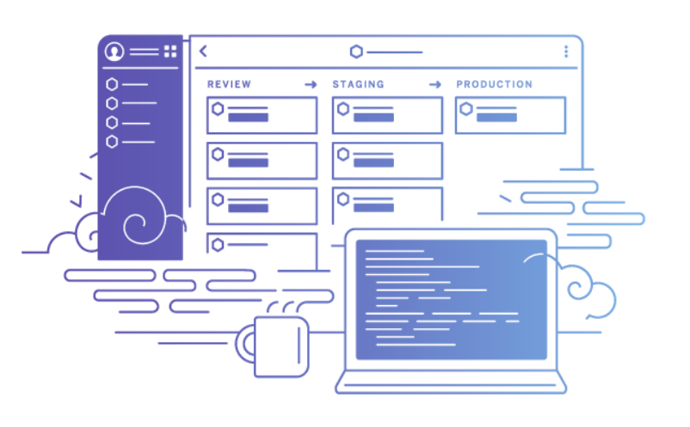
What is Heroku?
It’s a platform to deploy and host your applications for you.
Probably not what you would choose for a large company site, but handy for developers to prototype with or small business needs.
Friendly and easy to use, can learn on a free account, so we have set up six for today’s bootcamp.
Notes:
We are going to finish our first CI/CD pipeline by keeping it simple.
Our next exercise will deploy to a borrowed server in the cloud. Just a single server – to keep things simple
We will use a provider called 'Heroku' to host our server application in a Java execution environment.
[TALK THROUGH SLIDE – What is Heroku?]

Slide 14
Exercise 7 Deploying with Heroku
Set up a pipeline stage ‘Deploy’
Take a look at your team’s Heroku account (ready-made for you)
Do a GIT push operation to the target set up in Heroku
Go see your app! Be inspired!!

Slide 15
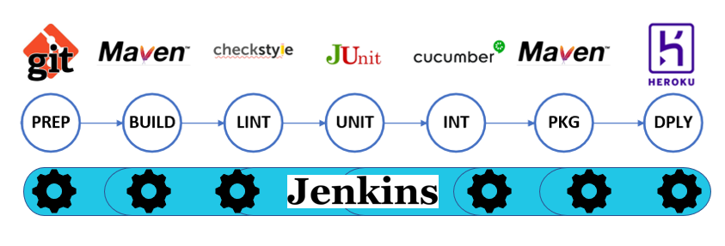
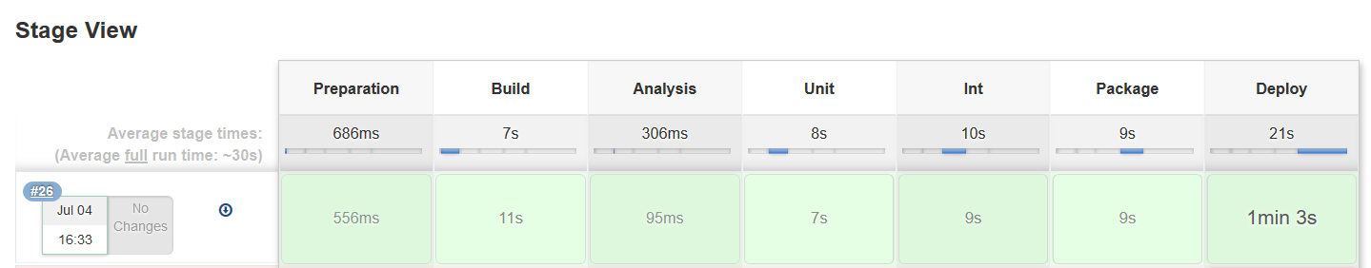
Bootcamp Pipeline
Notes:
completed the pipeline!
MASSIVE CHEERING!
We have actually shipped something!!!
Now all we have to do is wait for the money to roll in …
if only the software biz were that simple ;)

Slide 16

Deployment Strategies
In the real world, we have to deploy to more than one computer.
And sometimes that deployment fails
Let's take a look at some strategies to help us manage a multi-server deployment more effectively – preventing and fixing faults
Notes:
We mentioned how Google had one million servers.
Think about how that changes CI/CD:
- It's hard to update one million things
- And what happens if the deployment fails? It's hard to roll back one million things
What are we going to do?
Let's look at the options available to us.

Slide 17

Simple Deployment
Image credit: Itaysk Shakury
Notes:
Let's start with basics.
Here is the naïve, simplest example: Big Bang.
We've got three servers each running version 1 of some code.
We fire up a pipeline and change all three servers at once to run version 2.
It's nice and simple. But very risky.
If a fault is found in version 2 – how do we roll back?
How long does it take to complete?
Remember, the app is down during all this time: users just see 'this site is down for scheduled maintenance'
When we have to change every server all at once, application unavailability is a real problem. Irriatating for Facebook. Catastrophic for TSB (remember?)
And if you think it is bad for three servers – and it is! - wait until you have 3 million: Catastrophic.
This naïve appraoch is good for very small deployments and development.
But once you get to real web scale, forget it.

Slide 18

Rolling Deployment
Image credit: Itaysk Shakury
Notes:
So let's take a simple approach to improving this.
What if we change just one server at a time? We can also route the traffic as we go.
Some users will be on V2 software. Everybody else will be on V1 until the rollout completes.
This is challenging. You have to think about backward compatibility as you end up with different versions in your pool at the same time.
The example to think about is if you have added deleted columns from your database.
V1 code use a column called 'name'. V2 no longer uses this and has had it removed from the database.
What are the V1 nodes supposed to do after the first V2 code deploys and removes that database column?
They all break in a vomit of exceptions.
Even in the simpler cases where there is no database change, we need to be careful.
Monitoring is key to this rollout strategy as you need to be able to cancel the rollout if there are issues or potentially reverse the rollout if it is a catastrophe.

Slide 19
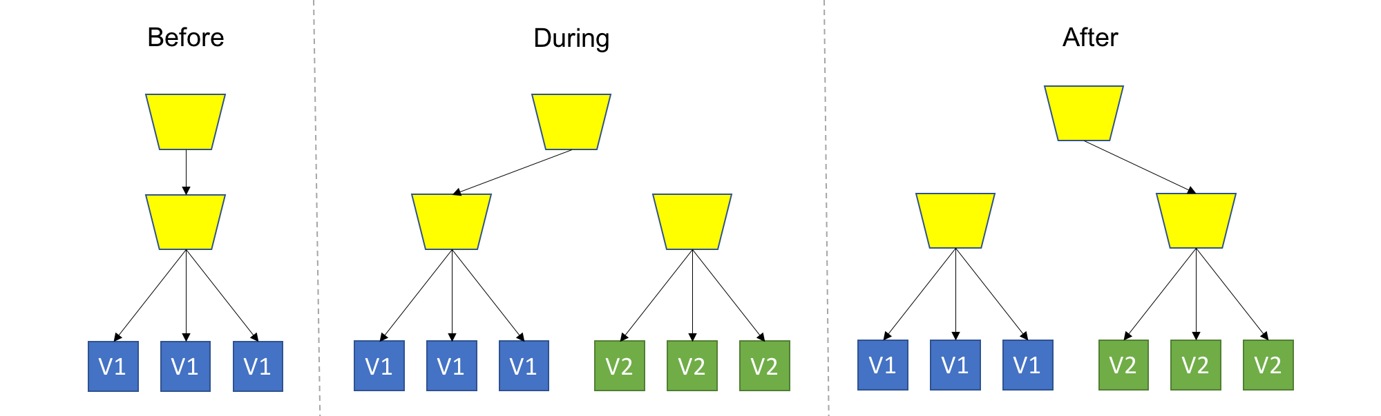
Blue Green Deployment
Image credit: Itaysk Shakury
Notes:
We can solve both problems – at a cost – by using Blue Green deployment.
We setup two identical production environments called Blue and Green Blue is currently live with production traffic Deploy new software to the green environment Verify the green environment Switch the traffic from the Blue to Green environment If any issues occur the rollback is to point traffic back to Blue Tools such as AWS Codedeploy can help you automate this sort of rollout.
Advantages:
* Zero downtime - Switching traffic back to the blue one is fast and easy.
* Can use for A/B user testing – divert a fraction of users to version 2
* With successful deployments, you always have a 'warm standby' system in case of hardware failure – roll to the other one
* Allows testing – especially load testing – to be done in production on a subset of server
Disadvantages:
* Double the costs
* Database schema changes across versions require thought. You have to ensure a migration path for data that allows for the new version – and any rollback

Slide 20

Canary Deployment
Image credit: Itaysk Shakury
Notes:
Canary deployment is named after taking a Canary into a coal mine:
You might not be familiar with this idea in 2019!
Coal miners used to simply dig a hole in the ground and mine stuff. Happy days.
But as they dug deeper, colourless toxic gases would build up in the mine.
Miners were poisoned.
The earliest warning system was to take a small bird – an actual canary – into the coal mine.
As the bird was smaller, it would be poisoned sooner – giving the miners a clear signal and valuable time to get out.
A canary deployment is the same idea: we deploy to a small test set of servers.
You can use any previous strategy to deploy the code – a Canary deployment is when you intentionally deploy, smoke test and back out on any problems.
Often, Canary builds/deploys are done every day to confirm the system really is deployable and working
The one major problem they solve is to prove that library code is still working.
As most builds use a package manager to pull in the latest version of a library, this test build proves that any upgrades are still compatible with our code.
If not, then only a small number of users are affected. And we can back out the change quickly, as it has only affected a few servers.
All other users are on the existing code and are none the wiser.

Slide 21
Deployment Testing
Apply only to live code
Health Checks - is it deployed right?
Smoke Tests - is it working right?
Notes:
Apply only to live code Health Checks - is it deployed right? Smoke Tests - is it working right?
These tests are new kinds of tests – different in nature to development tests. They are only relevant to code after it has been deployed and is running. Generally, a quick health check will be done to confirm the deployment worked and the app started up ok. Smoke Tests get their name from the electronics world: Turn it on - did any smoke come out? No? Then it's passed! In software, they are a little bit more involved. But they still prove out a selection of happy paths - enough to give confidence that all components are up and running, wired correctly.

Slide 22
Test Tools
Focus on HTTP response testing and UI interaction
RestAssured - HTTP API testing
@SpringBootTest - Spring tools
NightwatchJS
Selenium
Notes:
Note: Test tools for deployment generally focus on the public interfaces of apps: HTTP requests and responses for our web service APIs UI interactions - simulated clicking of web pages and typing keys - for user interfaces It's a broader kind of testing than developer testing

Slide 23

Chaos Monkey
Notes:
This is an interesting testing approach ...
Chaos Monkey is a piece of software that breaks components on purpose to test system behaviour or resilience.
It is used by NetFlix to test that their production servers can actually handle failure. For real!

Slide 24

Health Checks
Very basic test on deployed code in production
Verifies code is running – nothing more
Get an HTTP 200 OK from home page
Use normal HTTP test tools
SpringBootTest
Rest Assured
Jest/Express
Notes:
A Health Check is used to test that deployed code is actually running.
That's it – see if we get a basic 200 from a site – nothing more.
They are an example of a test that is only relevant to deployment.

Slide 25
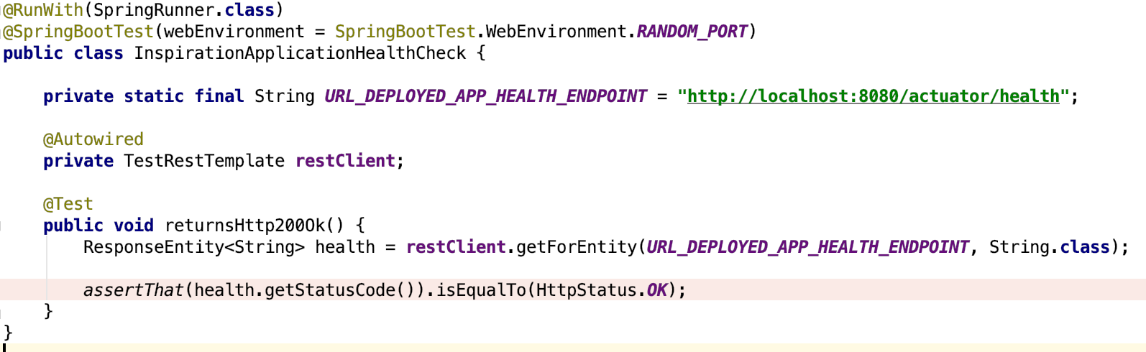
Example Health Check Code
Notes:
You can see how basic a health check is here.
This is a standard Spring Boot Web test.
It is plain unit test style – where we code up Arrange, Act, Assert sections as usual
We use Spring Boot's built-in health check endpoints that we built into our app.
We call one using HTTP GET – and check we get a 200 OK back.
Really simple – but highly effective. A rapid way to know if your deployment failed.

Slide 26

Monitoring and Metrics
Notes:
[TITLE SLIDE]

Slide 27

Continuous Monitoring
As our system runs, we continuously measure its performance.
Why?
Is our system still working?
Is it performing with acceptable non-functional requirements e.g. response times
Is infrastructure cost within the expected bounds?
Is it safe to deploy a new version?
Notes:
Note: This is part of the movement to 'shift left'.
Again, we want to know about any problems in our deployed code sooner.
Old school, we would wait for complaints and bug reports from users.
Shifting left, we measure performance of our own code so that we can work out for ourselves if it is broken.

Slide 28
What do we monitor?
What things tell us about system health?
Application log files (errors, exceptions)
Request traffic profile (page views, url, HTTP response codes, response times)
Availability of required downstream/thirdparty systems
Infrastructure metrics (CPU/RAM/Disk)
Costs of infrastructure should also be tracked
Monitor critical user journey on a website e.g. can customers login
Notes:
[READ SLIDE]

Slide 29
How?
Instrument our code
Structured Log output – decide what and where
Add measurement code – timing, counters
Consider triage add unique requestID or correlationID to logs
Notes:
The way we monitor our application is to instrument it.
That means adding extra lines of application code specifically to record measurements.
Common ways including structured logging – this is simply writing log statements in a fixed, machine-readable format,
Reporting tools can read this data and give searching and graphing.
It's critical to get this right early on – else you will struggle to access badly formatted data
We can also add timers and counters to record execution times or page views – these can be very useful both to engineering and marketing.
PRO-TIP: Add a 'correlation ID' - this is a Unique ID that we add to the web request as it enters our system and follows it around every component of our application.
That way we can track how every single subsystem handled it – and locate faults.

Slide 30
Reporting Tools
Common tools to search, sort and display data:
ELK - Elasticsearch-Logstash-Kibana for distributed logs
AWS CloudWatch for infrastructure metrics
Graphite and Grafana - graphing tools of metrics
Hystrix Dashboard - Integration points availability
Notes:
To best visualise these text logs, a whole series of grpahical tools has been created.
Perhaps you've used some at work?
[READ LIST]
Tools like Grafana can integrate with multiple data sources e.g. Cloudwatch for infrastructure metrics and ELK for application metrics giving you a holistic view with a single tool

Slide 31
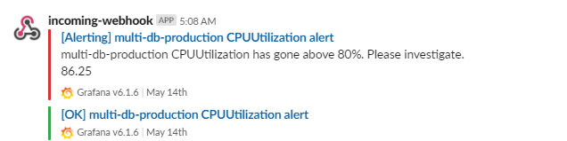
Alerting
Alert on metrics falling out of a desired range
response time greater than 10s
CPU usage greater then 75%
Send a notification somewhere e.g. Slack/SMS
Notes:
Once we can measure how our system is performing, we can set thresholds.
If the system performs worse than some limit, we can arrange to be notified
This is alerting – very common in DevOps – the legendary 2 AM SMS and it's not a drunk text from an Ex
Let's add alerting to our pipeline

Slide 32
Exercise 9. Add monitoring and alerting
Add basic uptime monitoring using www.uptimerobot.com
Create a free account
Point it at the live URL of our app
Login to the dashboard and view
Break your application and check it is picked up

Slide 33

Tea Break

Slide 34
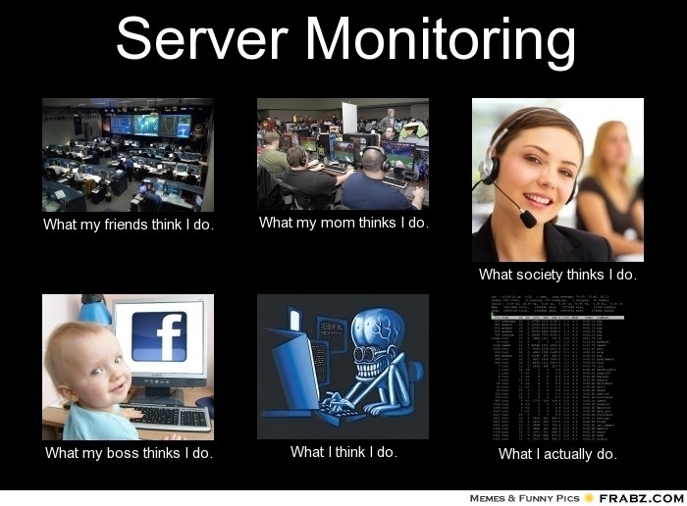
Lunch Break

